Slide 1

Online Examination System
Backend Development Project
Presented by:
Lakshay Kumar (2210990536)
Krishna Singh(2210990521)
Aryan (2210990174)
Ayush Bharti

Slide 2

Introduction
The Online Examination System is designed to simplify and automate the process of conducting exams online.
It provides a secure and user-friendly platform for students and administrators.

Slide 3

Project Objectives
Automate the examination process, reducing the need for physical presence and manual grading.
Enhance accessibility by making exams available to users anywhere.
Ensure security with robust authentication and authorization mechanisms.
Provide real-time results and feedback to students.

Slide 4

Project Scope
User Registration and Authentication
Exam Creation and Management
Question Bank Management
Exam Taking and aAutomatic Submission
Result Generation and Reporting

Slide 5

Technology Stack
Backend: Java (Spring Boot) for RESTful APIs.
Database: MySQL for storing user data, exams, and results.
Authentication: JWT (JSON Web Tokens) for security.(Optional): Frontend (HTML, CSS, JavaScript) for basic UI.

Slide 6
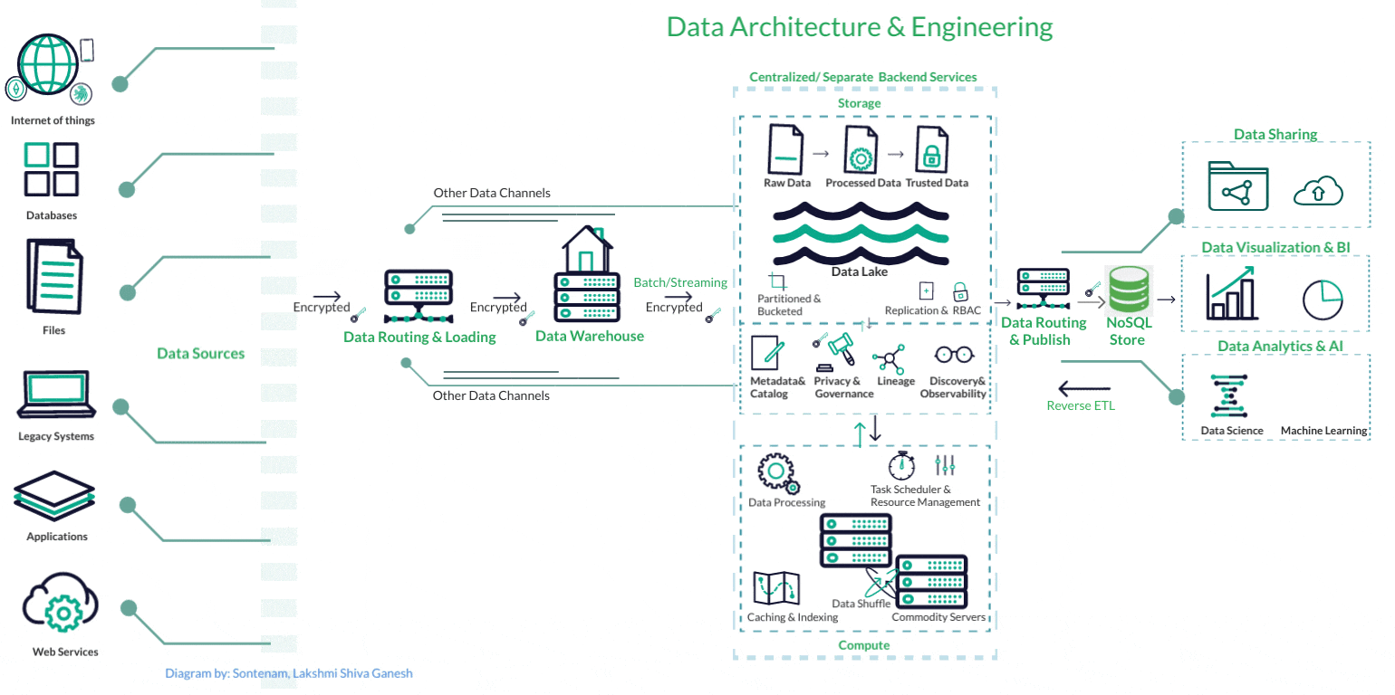
System Architecture
Three-tier architecture
Presentation layer
Business Logic layer
Data Access Layer

Slide 7

User Roles and Permissions
Admin: Create and manage exams, questions, and view reports
Student: Register, take exams and view results
Role-based access control to ensure security and proper permissions

Slide 8
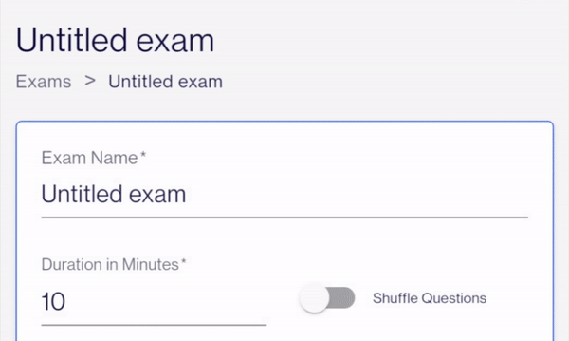
Exam Creation and management
Admins can create exams with various types of questions ( MCQ, True/False.
Exams can be timed, and equations can be randomized from the question bank

Slide 9

Question Bank
A categorized database of questions by subject, difficulty and type.
Facilitates easy selection of questions for exams
Allows admins to add, update or delete questions

Slide 10

Exam Taking Process
Students can start exams after logging in
A timer ensures exams are completed within the allotted time
The system automatically submits the exam when time expires

Slide 11

Result Generation
Automatic grading based on predefined correct answers
Immediate feedback to students with detailed results
Correct answers and explanations are provided for educational purposes

Slide 12

Analytics and reasoning
Detailed reports on exam performance for admins
Statistics like average scores, pass rates and individual performance
Helps in identifying trends and areas for development

Slide 13

Challenges faced
Scalability: Ensuring the system can handle many users simultaneously.
Security: Protecting user data and preventing unauthorized access
Data Consistency: Keeping data consistent across the system

Slide 14

Future Enhancements
Advanced Analytics: Introduce more sophisticated data analysis and reporting tools.
Proctoring Features: Implement online proctoring to prevent cheating
Mobile App: Develop a mobile version of the system for easier access.

Slide 15

Conclusion
The online examination system is a comprehensive solution for modern educational needs.
It streamlines the exam process, ensures security and provides valuable insights through analytics.

